Slide 1
W05D5
Midterm Project Kickoff
Instructor: Andrew Berry
Slides Modified from Eric Elmoznino

Slide 2
Outline for today
Project descriptions
Predicting flight delays
Clustering NYC neighborhoods
Project skeleton
How to plan the project
How to divide up tasks
GitHub essentials and demo
Evaluation criteria

Slide 3
Partners
@SilasWR & @Brian Han
@Chung Cheung & @Daria
@Shubhangi & @Shilpi Tiwari
@Albina Mussilova & @Garrett Brezsnyak
@Zachary Argentin & @Gustavo Cárdenas
@Katrin Pochtar & @Niklas Bergen
@Ramakrishna Tadavarty & @Ryan H

Slide 4
Project descriptions

Slide 5
Predicting flight delays
Supervised Learning:
Regression Problem: Predict delay of flights 1 week in advance
(Stretch) Multiclass Classification: Predict type of delay it will be
(Stretch) Binary Classification: Predict if the flight will be cancelled.
Feature Engineering
Sampling
JDBC connection to a Postgres database
Repository

Slide 6
Predicting flight delays: the data
4 separate tables:
flights: Departure and arrival information for flights in US from 2018 and 2019
fuel_comsumption: Consumption of different airlines from 2015-2019 aggregated per month
passengers: Total passengers on different routes from 2015-2019 aggregated per month
flights_test: Departure and arrival information for flights in US from January 2020. Use this as your test set. When you submit, this is how it should look: sample_submission.csv
Other APIs you find (e.g. a weather API)
Postgres database (credentials in compass activity):
Don’t: SELECT * FROM aviation without a WHERE clause
Do: Save result of query as CSV

Slide 7
Predicting flight delays: workflow
Pull a subset of the database and save as csv
Do some data exploration (guidance from this notebook)
Engineer features and train models (guidance from this notebook)
Submit results in the form of sample_submission.csv

Slide 8
Clustering NYC neighborhoods
Unsupervised Learning
Clustering Problem: Cluster using cultural, geographic, and transport features
Insights: See if clusters are predictive of economic indicators and/or demographics
Data Visualization
Using APIs for data enhancements
JSON parsing
Repository

Slide 9
Clustering NYC neighborhoods: the data
Parse nyc_geo.json into dataframe with:
Borough
Neighborhood
Latitude
Longitude
Join data with features from APIs:
Cultural: Foursquare, Yelp, Google, Meetups
Transport: Uber
Other: NYC Open Data
Any others you think of

Slide 10
Clustering NYC neighborhoods: where to start
Parse neighbourhood JSON data
Explore APIs and join features to dataframe
Do some data exploration (guidance from this notebook)
Engineer features and train models (guidance from this notebook)
Visualize clusters and relationships to economic/demographic variables
Submit results as submission.csv with columns “neighborhood”, “cluster_id”

Slide 11
Breakout - (15-20 minutes)
discuss approaches to both projects
Pros and Cons

Slide 12
Project Lifecycle

Slide 13
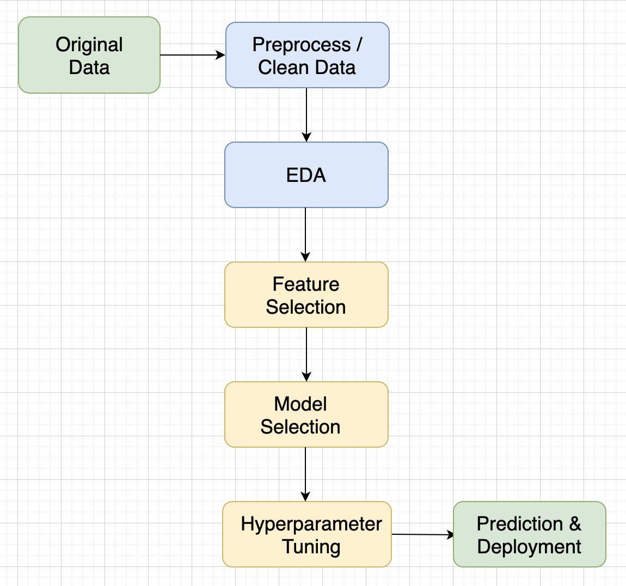
Lifecycle
No exact recipe, every project is different
Don’t to exploratory analysis just for the sake of it; use it to inform decisions
Model selection through cross-validation on the training set.
Test set untouched until submission

Slide 14

Model selection
Find the best model+hyperparameters through cross-validation on the train set
Report how well your best model does on the test set Fair estimate of how well your selected model would perform on unseen data once deployed
Notes:
Model selection:
Try a bunch of models and a bunch of hyperparameter settings.
Run cross-validation on them, passing in the train set as input.
Pick the model that has the best average validation performance across folds.
Get that best model’s predictions on the test set.

Slide 15
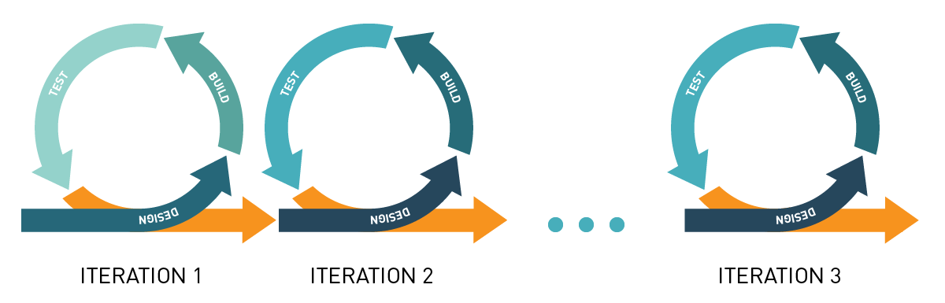
Iterative progress and difficulty
Make a minimum viable product (MVP) early
Dataset difficulty (e.g. one data source before merging many)
Model complexity (e.g. linear regression before xgboost)
Notes:
Reasons:
Easier to avoid bugs. Make sure simple things work before moving on. Example: if xgboost isn’t training, is it because your hyperparameters were wrong, or because you loaded your data wrong?
Learn as you go along. Working on a project makes the challenges clear. Better to figure out the challenges in a simplified context so that you scrap less code that you spent a long time working on.
Avoid catastrophic failure of any results. Get something working for the presentation, then build on it for as long as you can. MVP.
Dataset difficulty:
Performance can be boosted with feature engineering, but you should be able to get better than random results with just a few features taken directly from the dataset.

Slide 16
How to collaborate
Use GitHub to have 1 unified remote copy with all past versions
Dropbox etc. will not have a list of past working milestones to roll back to
Dropbox etc. will cause issues if one person is making changes to code that another person is using (due to constant syncing)
Try to parallelize, not pipeline (don’t want anyone to be blocked)
Ideas for parallelizing between team members:
Multiple tables/data sources. Can split EDA of each and come up with interesting insights
Can work on different ML models and/or feature engineering strategies
Can generate different visualizations/insights from models
Meet frequently to discuss insights/next steps and maintain accountability

Slide 17
GitHub essentials and demo

Slide 18
Git steps
1 person creates a repository on GitHub (with README.md)
Go to setting → manage access → invite a collaborator
Clone the repository cd [directory you want to work in] git clone [repository url] cd [repository name]
Make changes (e.g. create jupyter notebooks, add code, etc.) git add [file path] # add any new files to version control git commit -a -m "[your commit message]" # register changes as a new version
Sync with the remote (cloud) copy. Pull others’ changes, push your own git pull # remote changes -> your copy git push # your copy -> remote (error if there are changes you haven’t pulled)

Slide 19
The Basics of Git
Show branch list
$ git branch -a
Merging branch (be in the branch you want the other branch to merge to)
$ git merge branch_name
GITHUB BASICS
Check remote
$ git remote
Add remote repository
git remote add origin https://github.com/andrewhnberry/test_repo.git
Push
$ git push -u origin master
Pull
$ git pull
Initializing repo
$ git init
Add File(s)
$ git add <file>
Add all files
$ git add .
$ git add -all
Check status of working tree
$ git status
Committing
$ git commit -m ‘insert-comment’
Creating gitignore
$ touch .gitignore
New branch
$ git branch branch_name
Shift to new branch
$ git checkout branch_name

Slide 20
GitHub conflicts
Git does not constantly sync local+remote automatically like Google Docs. It syncs when you pull/push
What if you and a teammate were modifying the same code?
Example: you both worked on the same function, they pushed first, and you pull
Git will throw an error when you try to pull and will ask you to resolve conflicts
You’ll have to pick which changes to keep: yours, your teammate’s, or a mixture
Can be very difficult to resolve conflicts
Best solution: avoid working on the same files, or at least the same code
If you pull changes that don’t overlap with what you’re working on, git doesn’t overwrite what you’ve done or show conflicts

Slide 21
GitHub best practices
Commit+push working copies (milestone achieved, no errors)
Add useful commit messages (in case you need to roll back)
Work on separate features/files to avoid conflicts
Git pull frequently to avoid conflicts (local version very out of sync)
If data not too large, add to version control as well
In README, provide all details a new team member would need to navigate and modify the project

Slide 22
Evaluation criteria

Slide 23
Criteria
Presentation
Code quality
Approach to the problem
Accuracy and quality of model

Slide 24
Presentation
Present as if to a client (who has some data science knowledge)
Make it a story
What is the problem?
What is the dataset?
How did you analyze the dataset?
What were the findings?
You can walk through code, but only as a chronological reference for explaining how you analyzed the data
However, I recommend having no code at all
5 minutes

Slide 25
Presentation: Example structure
Motivation: What is the problem? Why is it important (either business, public good, or research perspective)?
Task: Problem from a technical perspective. Description of the dataset, features and targets, data exploration
Modeling: Important aspects of your approach. How did you process the data or engineer features? What model did you use? Use schematics!
Results: Visuals! Show metrics and experiments. Demo (if any)
Conclusions: What worked? What didn’t (and why)? How are we better off? Where could the project go next?

Slide 26
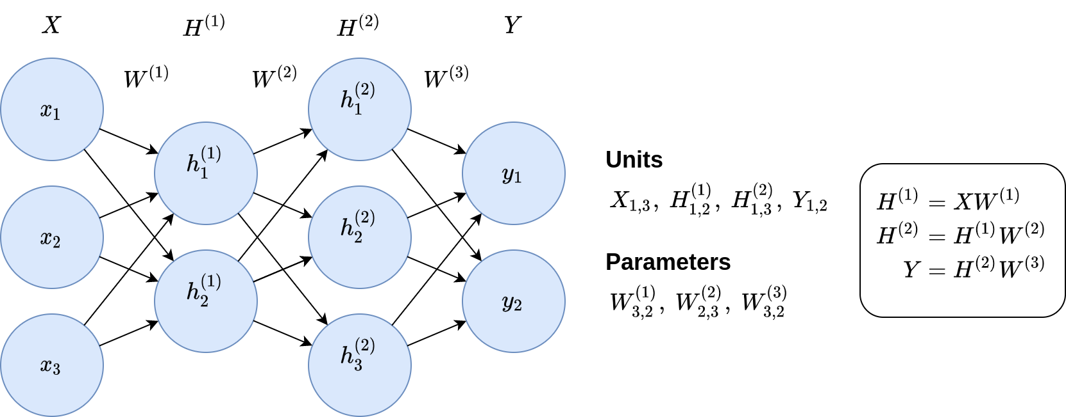
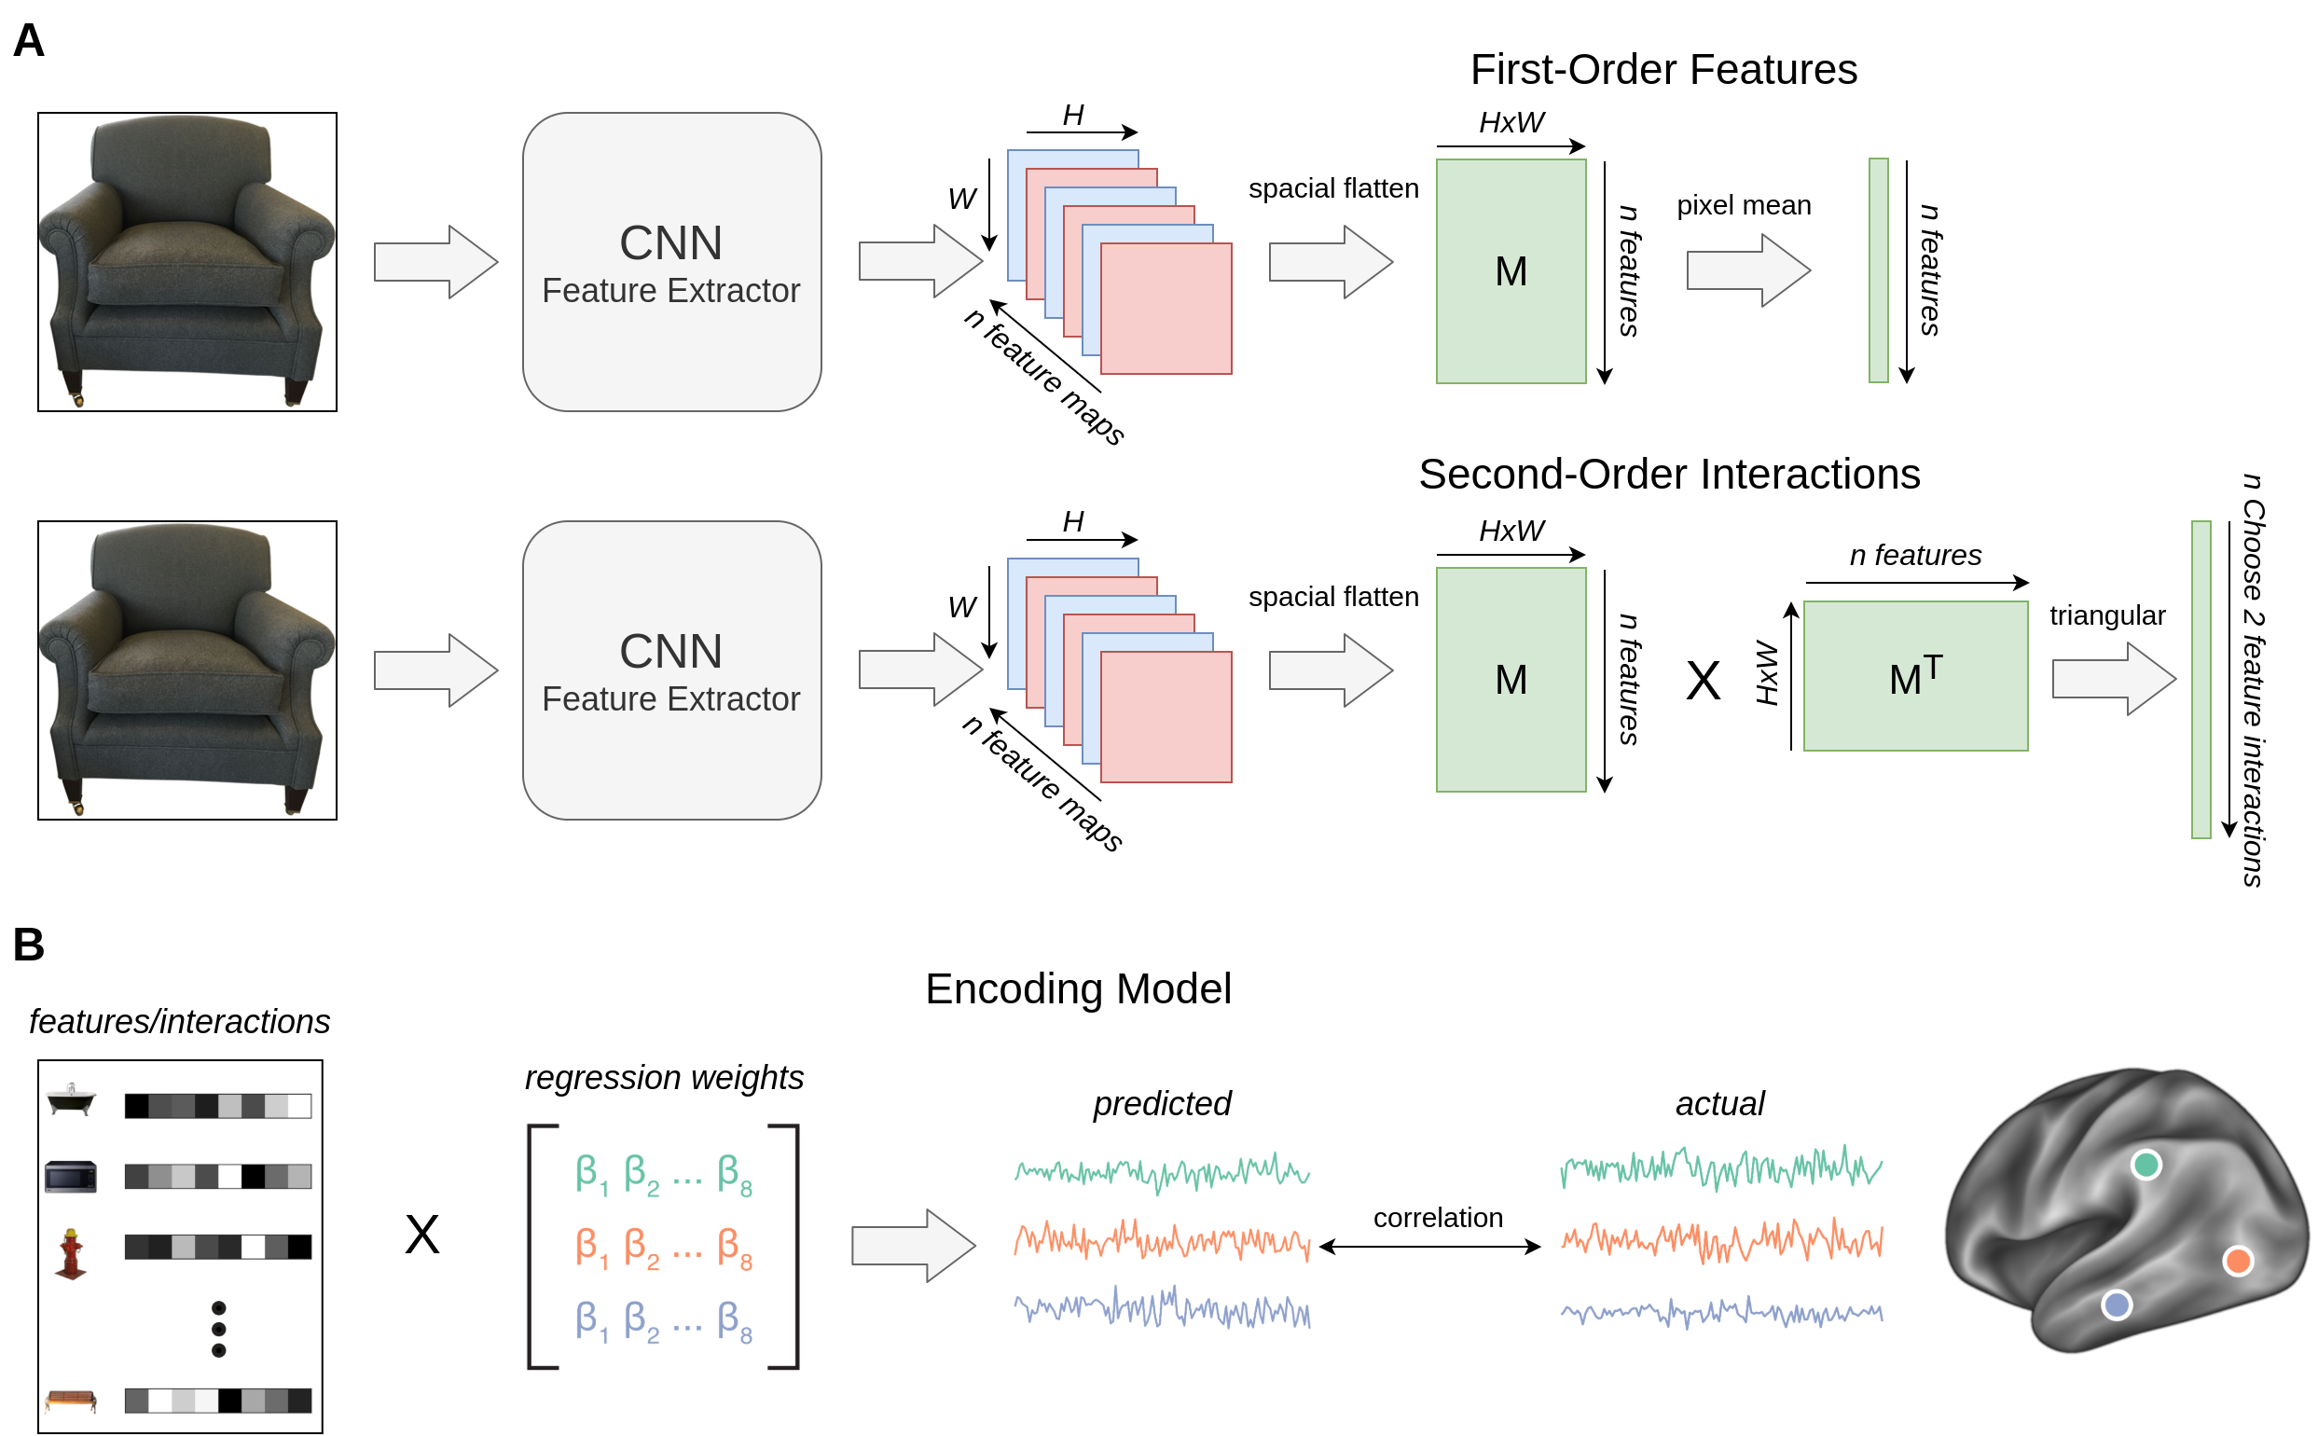
Presentation: draw.io figures
Good for schematics, model diagrams, shapes, math typesetting, etc.
Notes:
Free
Much easier than PowerPoint

Slide 27
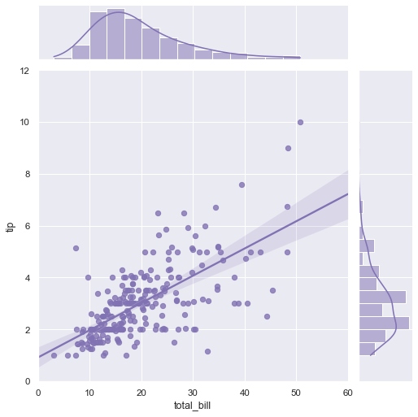
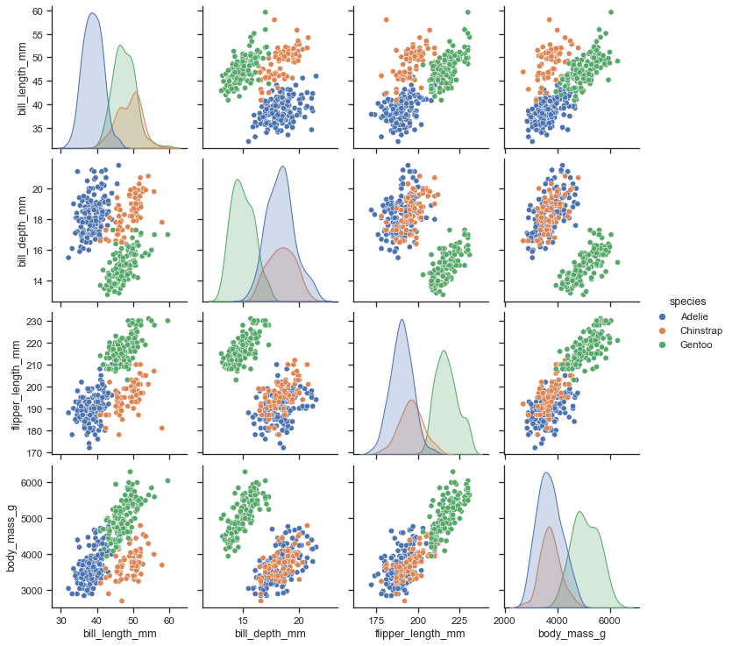
Presentation: python plotting libraries
Good for displaying information about your dataset and results
Notes:
Make a point of making good visualizations. They’re more intuitive, they tell a story, and they draw people’s attention.
In scientific papers, some people will just look at the figures and skip the text entirely.
They’re the only way of communicating with people without experience in data science.

Slide 28
Code quality
Modularization
Different files for different steps of the ML pipeline (e.g. data processing, model training, etc.)
Functions for unified code (if it has a short english description, it’s probably a function)
Readability
Meaningful variable names
Comments for code blocks, docstrings for functions
Periodically refactor code (e.g. remove old commented out code)
Robustness
Test your functions
Efficiency
Save processed data/trained model, only recreate when needed

Slide 29
Code quality: modularization
repo/
├── data
│ ├── raw_data.csv
│ └── preprocessed_data.csv
├── src
│ ├── modules
│ │ ├── data_preprocessing.py
│ │ └── modeling.py
│ │ └── figure_generation.py
│ ├── tests
│ │ ├── test_data_preprocessing.py
│ │ └── test_modeling.py
│ └── experiments.ipynb
├── output
│ ├── predictions.csv
│ ├── figures
│ │ ├── process_schematic.jpg
│ └── └── cluster_visualizations.jpg
└── README.md
# data_preprocessing.py
...
def load_preprocessed_data():
...
return X, y
...
# experiments.ipynb
from modules.data_preprocessing import load_data
from modules.modeling import train_models
...
X, y = load_data()
best_model, cv_performance = train_models(X, y)
...
Notes:
If you’re comfortable with it, try to make most of your helper functions in separate .py files and import them into your notebook

Slide 30
Code quality: docstrings
def add_binary(a, b):
'''
Returns the sum of two decimal numbers in binary digits.
Parameters:
a (int): A decimal integer
b (int): Another decimal integer
Returns:
binary_sum (str): Binary string of the sum of a and b
'''
binary_sum = bin(a+b)[2:]
return binary_sum

Slide 31
Code quality: avoid retraining model
def train_model(X, y):
...
if os.path.exists(model_filepath):
model = pickle.load(open(model_filepath, 'rb'))
else:
model = SVM()
model.fit(X_train, y_train)
y_pred = model.predict(X_test)
...
Pickle tutorial

Slide 32
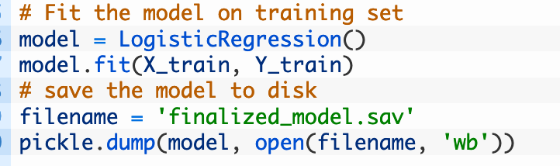
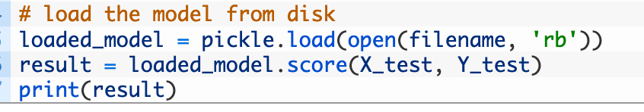
Pickling 101 - Very Easy!
import pickle
2.
3.

